Slide 1
Standard Representations of Regular Languages
Regular Languages
DFAs
Regular
Grammars
NFAs
Regular
Expressions
Costas Busch - RPI

Slide 2

When we say:
We are given
a Regular Language
We mean:
Language is in a standard
representation
Costas Busch - RPI

Slide 3
Elementary Questions about
Regular Languages
Costas Busch - RPI

Slide 4


Membership Question
Question:
Given regular language
and string
how can we check if ?
Answer:
Take the DFA that accepts
and check if is accepted
Costas Busch - RPI

Slide 5


DFA
DFA
Costas Busch - RPI

Slide 6
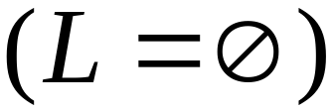
Question:
Given regular language
how can we check
if is empty: ?
Answer:
Take the DFA that accepts
Check if there is any path from
the initial state to a final state
Costas Busch - RPI

Slide 7


DFA
DFA
Costas Busch - RPI

Slide 8
Question:
Given regular language
how can we check
if is finite?
Answer:
Take the DFA that accepts
Check if there is a walk with cycle
from the initial state to a final state
Costas Busch - RPI

Slide 9
DFA
is infinite
DFA
is finite
Costas Busch - RPI

Slide 10


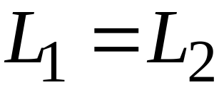
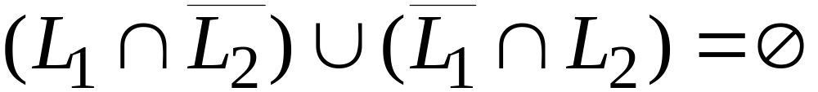
Question:
Given regular languages and
how can we check if ?
Answer:
Find if
Costas Busch - RPI

Slide 11
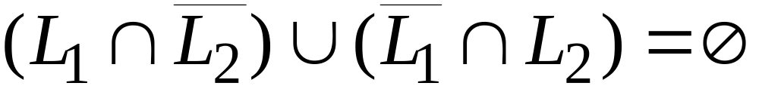
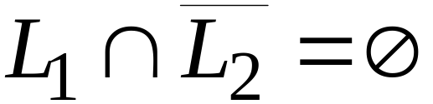
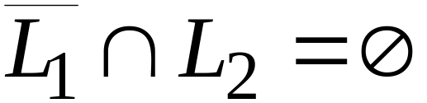


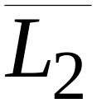
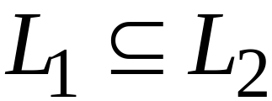
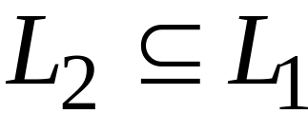
and
Costas Busch - RPI

Slide 12
Costas Busch - RPI

Slide 13
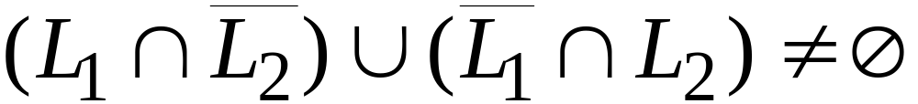
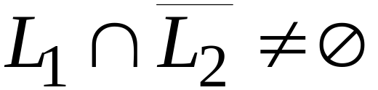
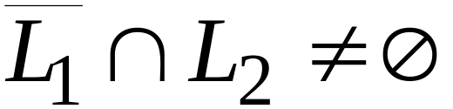
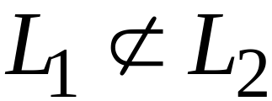
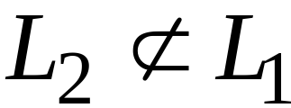
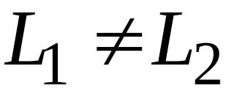
or
Costas Busch - RPI

Slide 14
Non-regular languages
Costas Busch - RPI

Slide 15
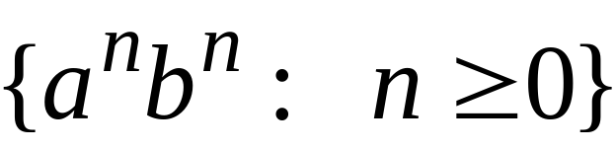
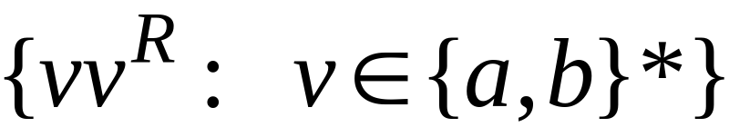


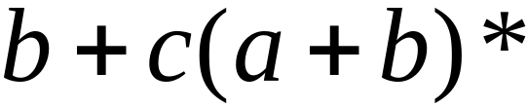

Non-regular languages
Regular languages
Costas Busch - RPI

Slide 16
How can we prove that a language
is not regular?
Prove that there is no DFA that accepts
Problem: this is not easy to prove
Solution: the Pumping Lemma !!!
Costas Busch - RPI

Slide 17

The Pigeonhole Principle
Costas Busch - RPI

Slide 18


pigeons
pigeonholes
Costas Busch - RPI

Slide 19
A pigeonhole must
contain at least two pigeons
Costas Busch - RPI

Slide 20



pigeons
...........
pigeonholes
...........
Costas Busch - RPI

Slide 21
The Pigeonhole Principle
pigeons
pigeonholes
There is a pigeonhole
with at least 2 pigeons
...........
Costas Busch - RPI

Slide 22
The Pigeonhole Principle and
DFAs
Costas Busch - RPI

Slide 23




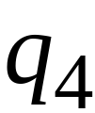


DFA with states
Costas Busch - RPI

Slide 24
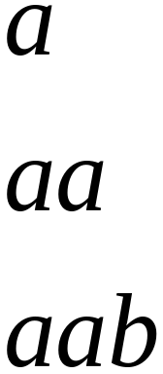
In walks of strings:
no state
is repeated
Costas Busch - RPI

Slide 25
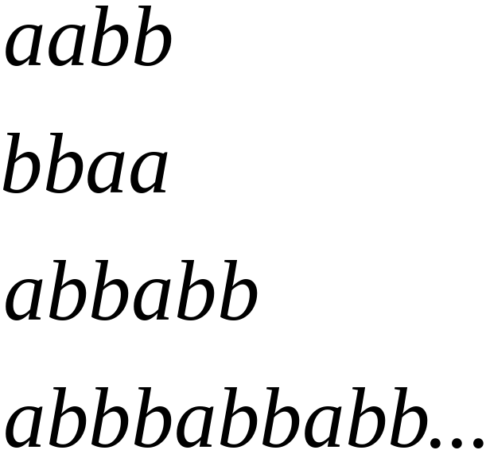
In walks of strings:
a state
is repeated
Costas Busch - RPI

Slide 26
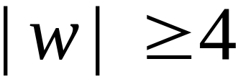
If string has length :
Then the transitions of string
are more than the states of the DFA
Thus, a state must be repeated
Costas Busch - RPI

Slide 27



In general, for any DFA:
String has length number of states
A state must be repeated in the walk of
walk of
......
......
Repeated state
Costas Busch - RPI

Slide 28
In other words for a string :
transitions are pigeons
states are pigeonholes
walk of
......
......
Repeated state
Costas Busch - RPI

Slide 29
The Pumping Lemma
Costas Busch - RPI

Slide 30

Take an infinite regular language
There exists a DFA that accepts
states
Costas Busch - RPI

Slide 31
Take string with
There is a walk with label :
.........
walk
Costas Busch - RPI

Slide 32
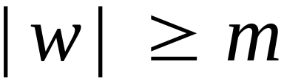
If string has length
(number
of states
of DFA)
then, from the pigeonhole principle:
a state is repeated in the walk
......
......
walk
Costas Busch - RPI

Slide 33
Let be the first state repeated in the
walk of
......
......
walk
Costas Busch - RPI

Slide 34




Write
......
......
Costas Busch - RPI

Slide 35


Observations:
length
number
of states
of DFA
length
......
......
Costas Busch - RPI

Slide 36

Observation:
The string
is accepted
......
......
Costas Busch - RPI

Slide 37

Observation:
The string
is accepted
......
......
Costas Busch - RPI

Slide 38

Observation:
The string
is accepted
......
......
Costas Busch - RPI

Slide 39
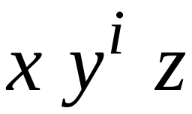

In General:
The string
is accepted
......
......
Costas Busch - RPI

Slide 40
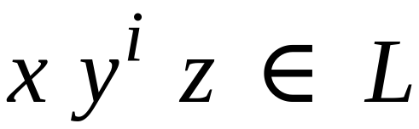
In General:
Language accepted by the DFA
......
......
Costas Busch - RPI

Slide 41
In other words, we described:
The Pumping Lemma !!!
Costas Busch - RPI

Slide 42


The Pumping Lemma:
Given a infinite regular language
there exists an integer
for any string with length
we can write
with and
such that:
Costas Busch - RPI

Slide 43
Applications of the Pumping Lemma
Costas Busch - RPI

Slide 44

Theorem:
The language
is not regular
Proof:
Use the Pumping Lemma
Costas Busch - RPI

Slide 45
Assume for contradiction
that is a regular language
Since is infinite
we can apply the Pumping Lemma
Costas Busch - RPI

Slide 46
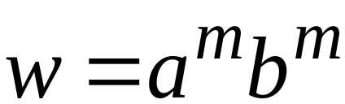
Let be the integer in the Pumping Lemma
Pick a string such that:
length
We pick
Costas Busch - RPI

Slide 47
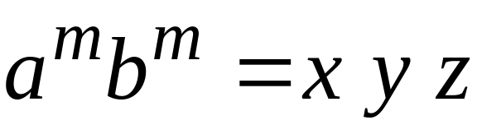

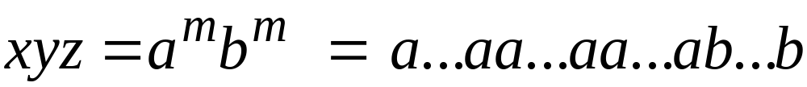
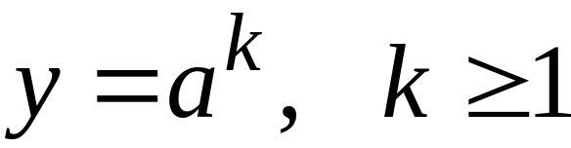
Write:
From the Pumping Lemma
it must be that length
Thus:
Costas Busch - RPI

Slide 48
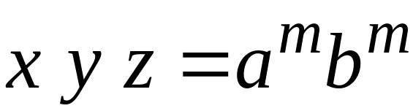

From the Pumping Lemma:
Thus:
Costas Busch - RPI

Slide 49

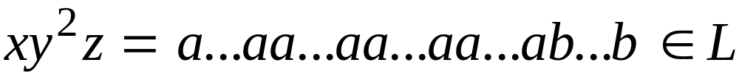
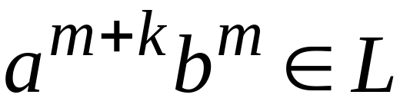
From the Pumping Lemma:
Thus:
Costas Busch - RPI

Slide 50
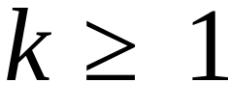
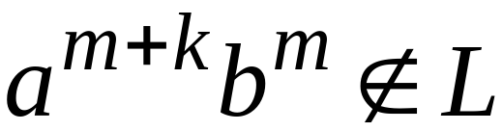
BUT:
CONTRADICTION!!!
Costas Busch - RPI

Slide 51
Therefore:
Our assumption that
is a regular language is not true
Conclusion:
is not a regular language
Costas Busch - RPI

Slide 52
Non-regular languages
Regular languages
Costas Busch - RPI

Slide 53
More Applications of the Pumping Lemma
Costas Busch - RPI

Slide 54
The Pumping Lemma:
Given a infinite regular language
there exists an integer
for any string with length
we can write
with and
such that:
Costas Busch - RPI

Slide 55
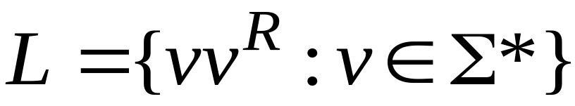
Non-regular languages
Regular languages
Costas Busch - RPI

Slide 56

Theorem:
The language
is not regular
Proof:
Use the Pumping Lemma
Costas Busch - RPI

Slide 57
Assume for contradiction
that is a regular language
Since is infinite
we can apply the Pumping Lemma
Costas Busch - RPI

Slide 58
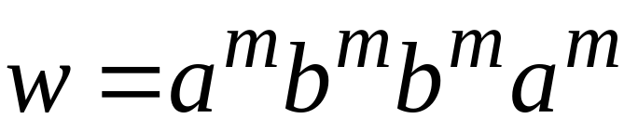
Let be the integer in the Pumping Lemma
Pick a string such that:
and
length
We pick
Costas Busch - RPI

Slide 59
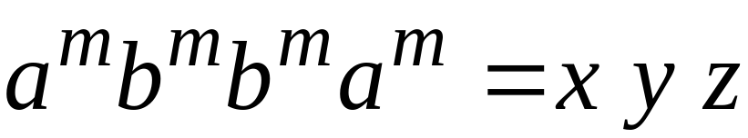
Write
From the Pumping Lemma
it must be that length
Thus:
Costas Busch - RPI

Slide 60
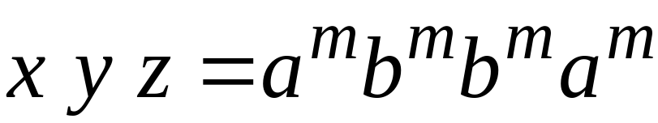
From the Pumping Lemma:
Thus:
Costas Busch - RPI

Slide 61

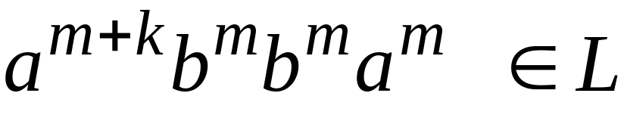
From the Pumping Lemma:
Thus:
Costas Busch - RPI

Slide 62

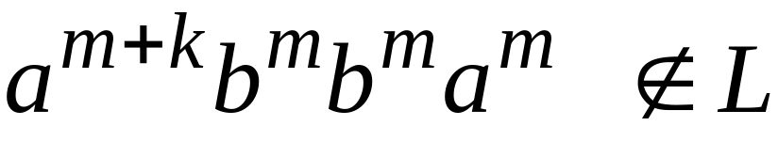
BUT:
CONTRADICTION!!!
Costas Busch - RPI

Slide 63
Therefore:
Our assumption that
is a regular language is not true
Conclusion:
is not a regular language
Costas Busch - RPI

Slide 64

Non-regular languages
Regular languages
Costas Busch - RPI

Slide 65
Theorem:
The language
is not regular
Proof:
Use the Pumping Lemma
Costas Busch - RPI

Slide 66
Assume for contradiction
that is a regular language
Since is infinite
we can apply the Pumping Lemma
Costas Busch - RPI

Slide 67
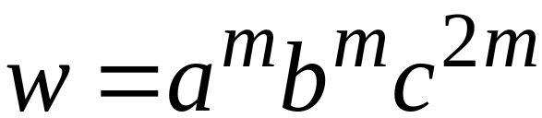
Let be the integer in the Pumping Lemma
Pick a string such that:
and
length
We pick
Costas Busch - RPI

Slide 68
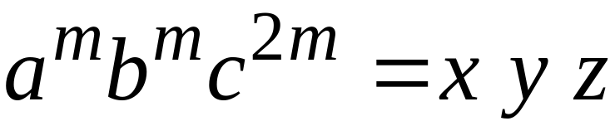

Write
From the Pumping Lemma
it must be that length
Thus:
Costas Busch - RPI

Slide 69
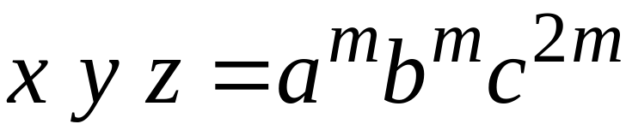
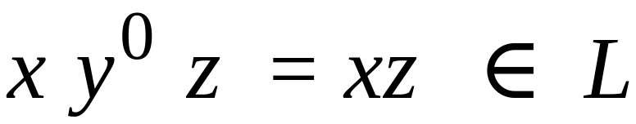
From the Pumping Lemma:
Thus:
Costas Busch - RPI

Slide 70
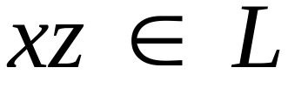

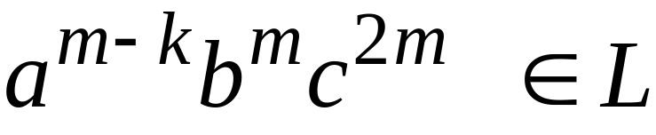
From the Pumping Lemma:
Thus:
Costas Busch - RPI

Slide 71
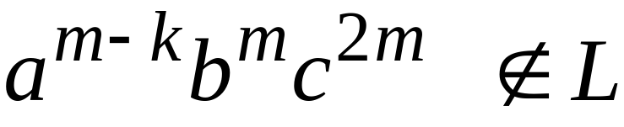
BUT:
CONTRADICTION!!!
Costas Busch - RPI

Slide 72
Therefore:
Our assumption that
is a regular language is not true
Conclusion:
is not a regular language
Costas Busch - RPI

Slide 73
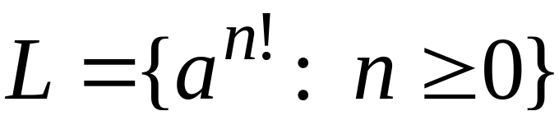
Non-regular languages
Regular languages
Costas Busch - RPI

Slide 74
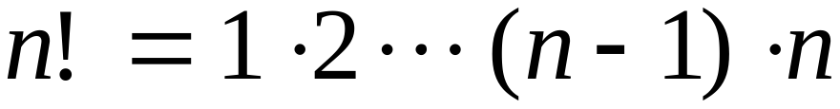
Theorem:
The language
is not regular
Proof:
Use the Pumping Lemma
Costas Busch - RPI

Slide 75
Assume for contradiction
that is a regular language
Since is infinite
we can apply the Pumping Lemma
Costas Busch - RPI

Slide 76
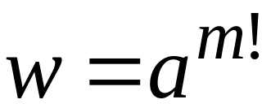
Let be the integer in the Pumping Lemma
Pick a string such that:
length
We pick
Costas Busch - RPI

Slide 77




Write
From the Pumping Lemma
it must be that length
Thus:
Costas Busch - RPI

Slide 78

From the Pumping Lemma:
Thus:
Costas Busch - RPI

Slide 79

From the Pumping Lemma:
Thus:
Costas Busch - RPI

Slide 80



Since:
There must exist such that:
Costas Busch - RPI

Slide 81





However:
for
for any
Costas Busch - RPI

Slide 82

BUT:
CONTRADICTION!!!
Costas Busch - RPI

Slide 83
Therefore:
Our assumption that
is a regular language is not true
Conclusion:
is not a regular language
Costas Busch - RPI

Slide 84
Lex
Costas Busch - RPI

Slide 85
Lex: a lexical analyzer
A Lex program recognizes strings
For each kind of string found
the lex program takes an action
Costas Busch - RPI

Slide 86
Output
Identifier: Var
Operand: =
Integer: 12
Operand: +
Integer: 9
Semicolumn: ;
Keyword: if
Parenthesis: (
Identifier: test
....
Input
Var = 12 + 9;
if (test > 20)
temp = 0;
else
while (a < 20)
temp++;
Lex
program
Costas Busch - RPI

Slide 87
In Lex strings are described
with regular expressions
Lex program
Regular expressions
“+”
“-”
“=“
/* operators */
“if”
“then”
/* keywords */
Costas Busch - RPI

Slide 88
Lex program
Regular expressions
(0|1|2|3|4|5|6|7|8|9)+
/* integers */
(a|b|..|z|A|B|...|Z)+
/* identifiers */
Costas Busch - RPI

Slide 89
integers
(0|1|2|3|4|5|6|7|8|9)+
[0-9]+
Costas Busch - RPI

Slide 90
identifiers
(a|b|..|z|A|B|...|Z)+
[a-zA-Z]+
Costas Busch - RPI

Slide 91
Each regular expression
has an associated action (in C code)
Examples:
Regular expression
Action
\n
linenum++;
[0-9]+
prinf(“integer”);
[a-zA-Z]+
printf(“identifier”);
Costas Busch - RPI

Slide 92
Default action: ECHO;
Prints the string identified
to the output
Costas Busch - RPI

Slide 93
A small lex program
%%
[ \t\n] ; /*skip spaces*/
[0-9]+
printf(“Integer\n”);
[a-zA-Z]+
printf(“Identifier\n”);
Costas Busch - RPI

Slide 94
Output
Input
Integer
Identifier
Identifier
Integer
Integer
Integer
1234 test
var 566 78
9800
Costas Busch - RPI

Slide 95
%{
int linenum = 1;
%}
Another program
%%
[ \t] ; /*skip spaces*/
\n
linenum++;
[0-9]+
prinf(“Integer\n”);
[a-zA-Z]+
printf(“Identifier\n”);
.
printf(“Error in line: %d\n”,
linenum);
Costas Busch - RPI

Slide 96
Output
Input
Integer
Identifier
Identifier
Integer
Integer
Integer
Error in line: 3
Identifier
1234 test
var 566 78
9800 +
temp
Costas Busch - RPI

Slide 97
Lex matches the longest input string
Example:
Regular Expressions
“if”
“ifend”
Input:
ifend if
Matches: “ifend” “if”
Costas Busch - RPI

Slide 98
Internal Structure of Lex
Lex
Regular
expressions
Minimal
DFA
NFA
DFA
The final states of the DFA are
associated with actions
Costas Busch - RPI

